Slide 1

Market Basket Analysis
Group AA Anastasiia Tagiltseva | Doris Macean | Doyun Shin |Emil Ahmadov

Slide 2

Instacart Business Objectives
Identifying consumer purchasing behavior
Types of products that need to be offered in wide range
Which products substitute each other?
Which items complement each other?

Slide 3
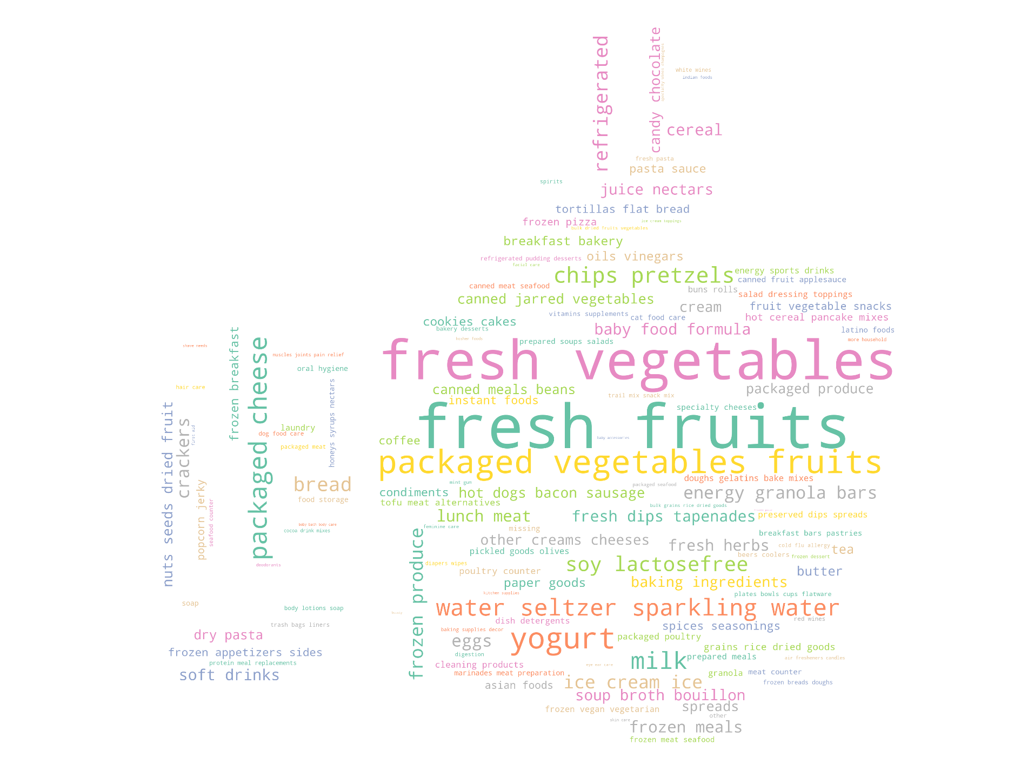

Exploratory Data Analysis

Slide 4
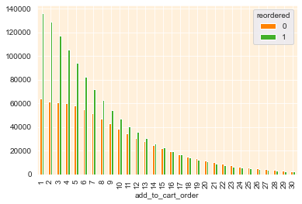
Exploratory Data Analysis

Slide 5
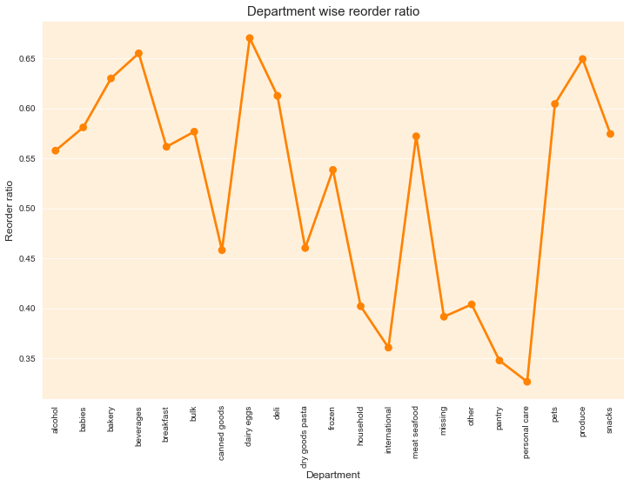
Reorder rate

Slide 6
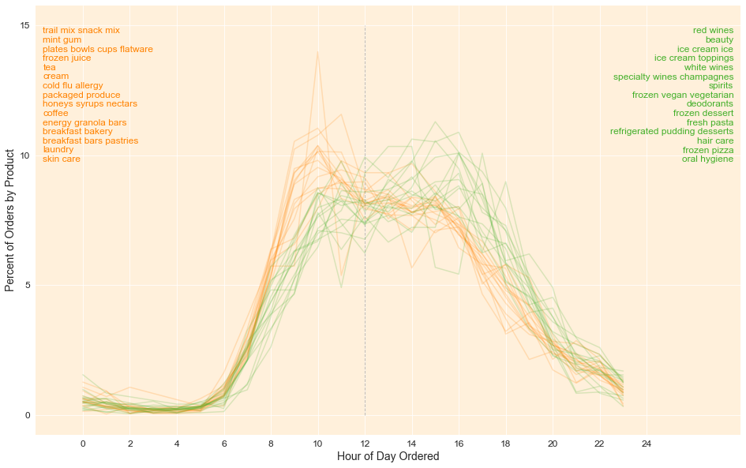
Exploratory Data Analysis

Slide 7
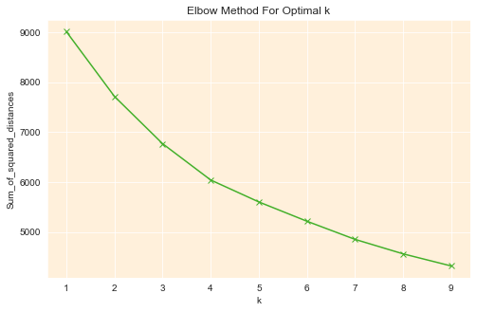
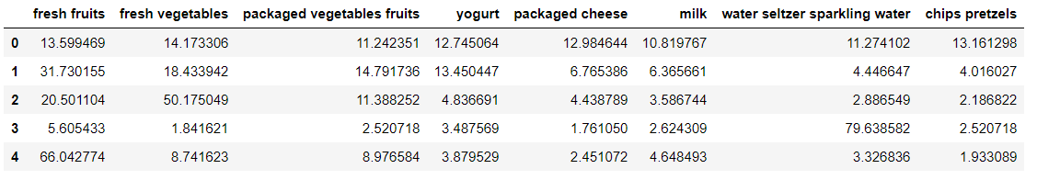
Customer Clusterization

Slide 8
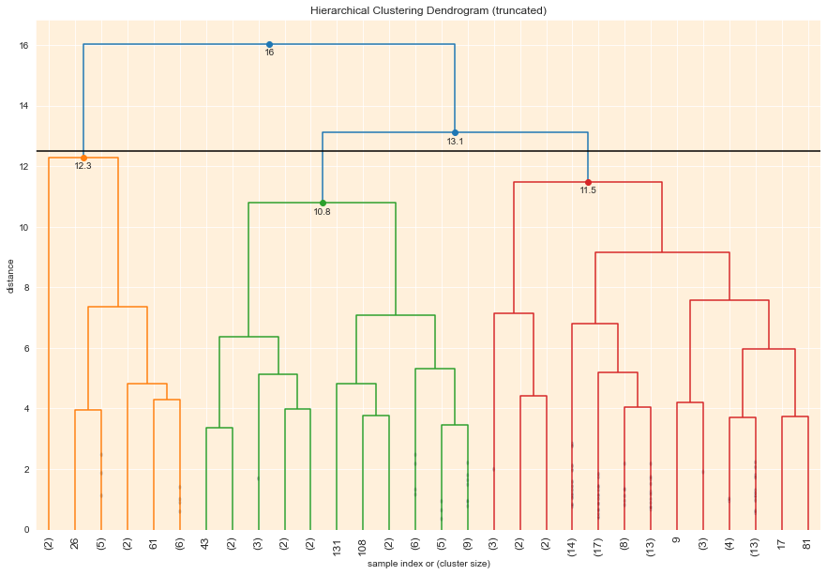
Product Clusterization
clusters | 1 | 2 | 3
count | 954 807 | 189 408 | 874 672
reorder_rate | 0.66 | 0.36 | 0.50
add_to_cart_mean | 6.53 | 9.10 | 8.98
order_dow | 2.75 | 2.63 | 2.80
order_hour_of_day | 13.52 | 13.39 | 13.53
days_since_prior_order | 11.21 | 11.63 | 10.73
size | 17.00 | 34.00 | 82.00

Slide 9
Association - General
Popular Products (quantity based)
Fresh fruits
fresh vegetables
packaged vegetables fruits
Substitutes:
Vegetables and Pretzels
Vegetables and Crackers
Fruits and Ice Creams
Complements:
Herbs and Vegetables
Vegetables and Fruits

Slide 10
Association – “1st Things First”
1st Order Only
First 15 Items
Why is the customer trying online groceries shopping at all?
What are the primary reasons the customer is making this order?
Vegetables and Fruits

Slide 11
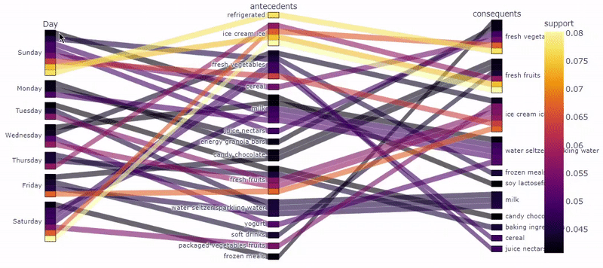
Association – Days of the Week

Slide 12
Association – Days of the Week
Substitutes Highlights
Soy milk and milk
Frozen Meals and Fresh Vegetables
Milk and Water
Cereal and Vegetables
Fruits and Ice Creams
Monday
Granola Bar and Vegetables
Candy bars and Fresh Fruits
Saturday
Vegetables and Juice Nectars

Slide 13
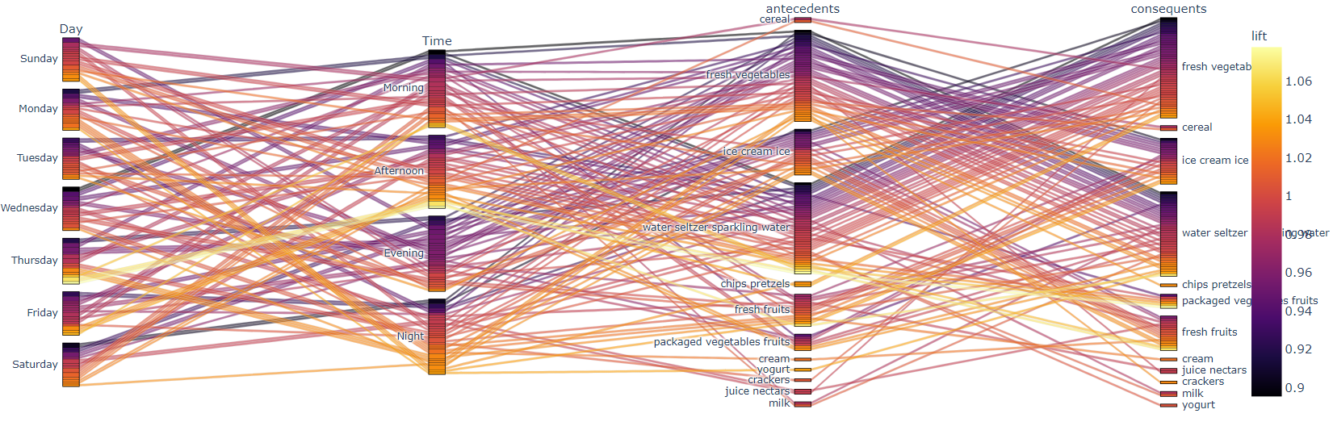
Morning/Afternoon/Evening/Night per Day of the Week

Slide 14
Deployment Plan:
Pre-
Pilot program
Recommendation system
Full
Making necessary adjustments based on reviews
Post-
Recommendation system based on association rules
Adapt the app for this purpose
Get feedback from users
Periodical assessments
Continuous evaluation
Using complete dataset
Recommendations according to day and time

